Slide 1
PRE-MENOPAUSAL YEARS
Finding Your Power

Slide 2
Outline
Segment 1:
Physiology
Meditation
Movement
Reflect on worksheet: Identifying areas where power is needed

Slide 3
THE BASICS
The power of physiology:
Physiology of the menstrual cycle:
Hormones
Ovaries
Uterus

Slide 4
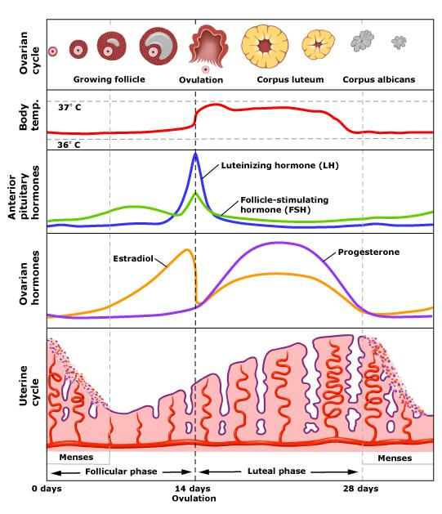
Menstrual Cycle
Average length: 28 days
Bleed is shedding of uterine lining.
Bleed is signaled with hormone shifts.
Ovulation happens mid-cycle, also signaled by hormone levels.
Notes:
Day 1 is first day of bleeding. Ovulation is the release of an egg from the ovary. It happens mid-cycle for most women. Ovulation is signaled by LH spike the 12-24 hours prior and is also when estrogen levels (which have been rising) will drop. Progesterone is dominant the second half of the cycle and if the egg is fertilized, is responsible for pregnancy maintenance until the placenta forms and takes over.

Slide 5
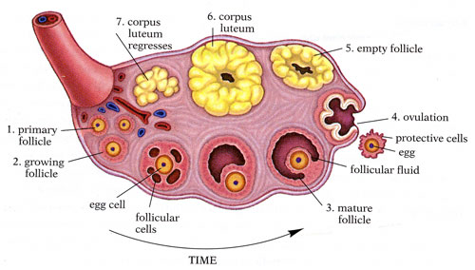
Ovaries
Where we store eggs
Where eggs mature and are released
Produce hormones

Slide 6
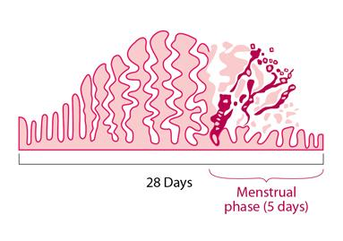
Uterus
Muscle that can be site of cramping – Magnesium helps
Cervix: cramping
Lining builds throughout cycle
Create space for fertilized egg
Then sheds with menses

Slide 7
Two Sets of Hormones
FSH and LH from pituitary
Estrogen and progesterone from the ovaries
(Testosterone): insulin resistance triggers more and irregularity
Notes:
FSH is brain signal to make follicle. LH is brain signal to ovulate and develop corpus luteum. Estrogen made primarily in ovaries, and when pregnant by placenta. Progesterone is made by the corpus luteum in the ovary, as well as in the ovary itself and in the adrenal glands

Slide 8
Meditation
Finding your inner power:
See yourself as a power source = empowerment

Slide 9
Movement for Power
Sun salutations x 3: open, stretch, build heat
“The hundred” Pilates movement to build core strength and heat

Slide 10
Empowerment Exercise
Worksheet review
Visualize being empowered
Identify obstacles
Give yourself permission to remove obstacles
Cultivate lifestyle habits to empowerment

